Slide 1

Module 15 - Application Case Study – Advanced MRI Reconstruction
Lecture 15.2 – Kernel Optimizations

Slide 2
Objective
To learn how to apply parallel programming techniques to an application
Determining parallelism structure
Loop transformations
Memory layout considerations
Validation

Slide 3
First Version of the FHD Kernel.
__global__ void cmpFhD(float* rPhi, iPhi, rD, iD,
kx, ky, kz, x, y, z, rMu, iMu, rFhD, iFhD, int N) {
int m = blockIdx.x * FHD_THREADS_PER_BLOCK + threadIdx.x;
rMu[m] = rPhi[m]*rD[m] + iPhi[m]*iD[m];
iMu[m] = rPhi[m]*iD[m] – iPhi[m]*rD[m];
for (int n = 0; n < N; n++) {
float expFhD = 2*PI*(kx[m]*x[n] + ky[m]*y[n] + kz[m]*z[n]);
float cArg = cos(expFhD); float sArg = sin(expFhD);
rFhD[n] += rMu[m]*cArg – iMu[m]*sArg;
iFhD[n] += iMu[m]*cArg + rMu[m]*sArg;
}
}

Slide 4
Loop Fission
for (m = 0; m < M; m++) {
rMu[m] = rPhi[m]*rD[m] +
iPhi[m]*iD[m];
iMu[m] = rPhi[m]*iD[m] –
iPhi[m]*rD[m];
for (n = 0; n < N; n++) {
expFhD = 2*PI*(kx[m]*x[n] +
ky[m]*y[n] +
kz[m]*z[n]);
cArg = cos(expFhD);
sArg = sin(expFhD);
rFhD[n] += rMu[m]*cArg –
iMu[m]*sArg;
iFhD[n] += iMu[m]*cArg +
rMu[m]*sArg;
}
}
(a) F^{H}D computation
for (m = 0; m < M; m++) {
rMu[m] = rPhi[m]*rD[m] +
iPhi[m]*iD[m];
iMu[m] = rPhi[m]*iD[m] –
iPhi[m]*rD[m];
}
for (m = 0; m < M; m++) {
for (n = 0; n < N; n++) {
expFhD = 2*PI*(kx[m]*x[n] +
ky[m]*y[n] +
kz[m]*z[n]);
cArg = cos(expFhD);
sArg = sin(expFhD);
rFhD[n] += rMu[m]*cArg –
iMu[m]*sArg;
iFhD[n] += iMu[m]*cArg +
rMu[m]*sArg;
}
} (b) after loop fission

Slide 5
cmpMu Kernel
__global__ void cmpMu(float* rPhi, iPhi, rD, iD, rMu, iMu)
{
int m = blockIdx.x * MU_THREAEDS_PER_BLOCK + threadIdx.x;
rMu[m] = rPhi[m]*rD[m] + iPhi[m]*iD[m];
iMu[m] = rPhi[m]*iD[m] – iPhi[m]*rD[m];
}

Slide 6
Loop Interchange of the FHD Computation
for (m = 0; m < M; m++) {
for (n = 0; n < N; n++) {
expFhD = 2*PI*(kx[m]*x[n] +
ky[m]*y[n] +
kz[m]*z[n]);
cArg = cos(expFhD);
sArg = sin(expFhD);
rFhD[n] += rMu[m]*cArg –
iMu[m]*sArg;
iFhD[n] += iMu[m]*cArg +
rMu[m]*sArg;
}
} (a) before loop interchange
for (n = 0; n < N; n++) {
for (m = 0; m < M; m++) {
expFhD = 2*PI*(kx[m]*x[n] +
ky[m]*y[n] +
kz[m]*z[n]);
cArg = cos(expFhD);
sArg = sin(expFhD);
rFhD[n] += rMu[m]*cArg –
iMu[m]*sArg;
iFhD[n] += iMu[m]*cArg +
rMu[m]*sArg;
}
} (b) after loop interchange

Slide 7
Second Option of the FHD Kernel
__global__ void cmpFhD(float* rPhi, iPhi, phiMag,
kx, ky, kz, x, y, z, rMu, iMu, int M) {
int n = blockIdx.x * FHD_THREADS_PER_BLOCK + threadIdx.x;
for (int m = 0; m < M; m++) {
float expFhD = 2*PI*(kx[m]*x[n]+ky[m]*y[n]+kz[m]*z[n]);
float cArg = cos(expFhD);
float sArg = sin(expFhD);
rFhD[n] += rMu[m]*cArg – iMu[m]*sArg;
iFhD[n] += iMu[m]*cArg + rMu[m]*sArg;
}
}

Slide 8
Using Registers to Reduce Memory Accesses
__global__ void cmpFhD(float* rPhi, iPhi, phiMag,
kx, ky, kz, x, y, z, rMu, iMu, int M) {
int n = blockIdx.x * FHD_THREADS_PER_BLOCK + threadIdx.x;
float xn_r = x[n]; float yn_r = y[n]; float zn_r = z[n];
float rFhDn_r = rFhD[n]; float iFhDn_r = iFhD[n];
for (int m = 0; m < M; m++) {
float expFhD = 2*PI*(kx[m]*xn_r+ky[m]*yn_r+kz[m]*zn_r);
float cArg = cos(expFhD);
float sArg = sin(expFhD);
rFhDn_r += rMu[m]*cArg – iMu[m]*sArg;
iFhDn_r += iMu[m]*cArg + rMu[m]*sArg;
}
rFhD[n] = rFhD_r; iFhD[n] = iFhD_r;
}

Slide 9
Chunking k-space Data to Fit into Constant Memory
__constant__ float kx_c[CHUNK_SIZE],
ky_c[CHUNK_SIZE], kz_c[CHUNK_SIZE];
…
__ void main() {
int i;
for (i = 0; i < M/CHUNK_SIZE; i++);
cudaMemcpyToSymbol(kx_c,&kx[i*CHUNK_SIZE],4*CHUNK_SIZE, cudaMemCpyHostToDevice);
cudaMemcpyToSymbol(ky_c,&ky[i*CHUNK_SIZE],4*CHUNK_SIZE, cudaMemCpyHostToDevice);
cudaMemcpyToSymbol(kz_c,&kz[i*CHUNK_SIZE],4*CHUNK_SIZE, cudaMemCpyHostToDevice);
…
cmpFhD<<<FHD_THREADS_PER_BLOCK, N/FHD_THREADS_PER_BLOCK>>> (rPhi, iPhi, phiMag, x, y, z, rMu, iMu, CHUNK_SIZE);
}
/* Need to call kernel one more time if M is not */
/* perfect multiple of CHUNK SIZE */
}
Notes:
The algorithms for Q and FHd are nearly identical, so in the interest of time we’ll examine only Q.
There are M scan points, with the 3D scan data represented by kx, ky, kz, and phi.
There are N pixels, with the 3D pixel data represented by x, y, and z (inputs) and Q (output).
As you can see, the algorithm is embarrassingly data-parallel.
Each iteration of the outer loop corresponds to a single point of scan data. For that single point of scan data, we first compute the magnitude-squared of phi. Then, the inner loop iterates over all the pixels, because the current scan data point contributes to the value of Q at every pixel. In other words, the value of Q at each pixel depends on every scan point. Clearly, the algorithm is O(MN).
Examining the inner loop more closely, we see that there are 10 floating-point arithmetic operations, 2 floating-point trig operations, and 10 loads. This instruction mix hints at the bottlenecks we face as we map this algorithm to the G80.

Slide 10
Revised FHD Kernel – Constant Memory
__global__ void cmpFhD(float* rPhi, iPhi, phiMag,
x, y, z, rMu, iMu, int M) {
int n = blockIdx.x * FHD_THREADS_PER_BLOCK + threadIdx.x;
float xn_r = x[n]; float yn_r = y[n]; float zn_r = z[n];
float rFhDn_r = rFhD[n]; float iFhDn_r = iFhD[n];
for (m = 0; m < M; m++) {
float expFhD = 2*PI*(kx_c[m]*xn_r+ky_c[m]*yn_r+kz_c[m]*zn_r);
float cArg = cos(expFhD);
float sArg = sin(expFhD);
rFhDn_r += rMu[m]*cArg – iMu[m]*sArg;
iFhDn_r += iMu[m]*cArg + rMu[m]*sArg;
}
rFhD[n] = rFhD_r; iFhD[n] = iFhD_r;
}

Slide 11
Using Hardware __sin() and __cos()
__global__ void cmpFhD(float* rPhi, iPhi, phiMag,
x, y, z, rMu, iMu, int M) {
int n = blockIdx.x * FHD_THREADS_PER_BLOCK + threadIdx.x;
float xn_r = x[n]; float yn_r = y[n]; float zn_r = z[n];
float rFhDn_r = rFhD[n]; float iFhDn_r = iFhD[n];
for (int m = 0; m < M; m++) {
float expFhD = 2*PI*(k[m].x*xn_r+k[m].y*yn_r+k[m].z*zn_r);
float cArg = __cos(expFhD);
float sArg = __sin(expFhD);
rFhDn_r += rMu[m]*cArg – iMu[m]*sArg;
iFhDn_r += iMu[m]*cArg + rMu[m]*sArg;
}
rFhD[n] = rFhD_r; iFhD[n] = iFhD_r;
}
Notes:
The algorithms for Q and FHd are nearly identical, so in the interest of time we’ll examine only Q.
There are M scan points, with the 3D scan data represented by kx, ky, kz, and phi.
There are N pixels, with the 3D pixel data represented by x, y, and z (inputs) and Q (output).
As you can see, the algorithm is embarrassingly data-parallel.
Each iteration of the outer loop corresponds to a single point of scan data. For that single point of scan data, we first compute the magnitude-squared of phi. Then, the inner loop iterates over all the pixels, because the current scan data point contributes to the value of Q at every pixel. In other words, the value of Q at each pixel depends on every scan point. Clearly, the algorithm is O(MN).
Examining the inner loop more closely, we see that there are 10 floating-point arithmetic operations, 2 floating-point trig operations, and 10 loads. This instruction mix hints at the bottlenecks we face as we map this algorithm to the G80.

Slide 12
Validating Reconstructed Image Using Peak Signal-to-Noise Ratio
A.N. Netravali and B.G. Haskell, Digital Pictures: Representation, Compression, and Standards (2nd Ed), Plenum Press, New York, NY (1995).
I₀ is a known, “perfect” answer. This is typically done by creating k-space samples for a known image, producing a reconstructed image, and compare the two.

Slide 13
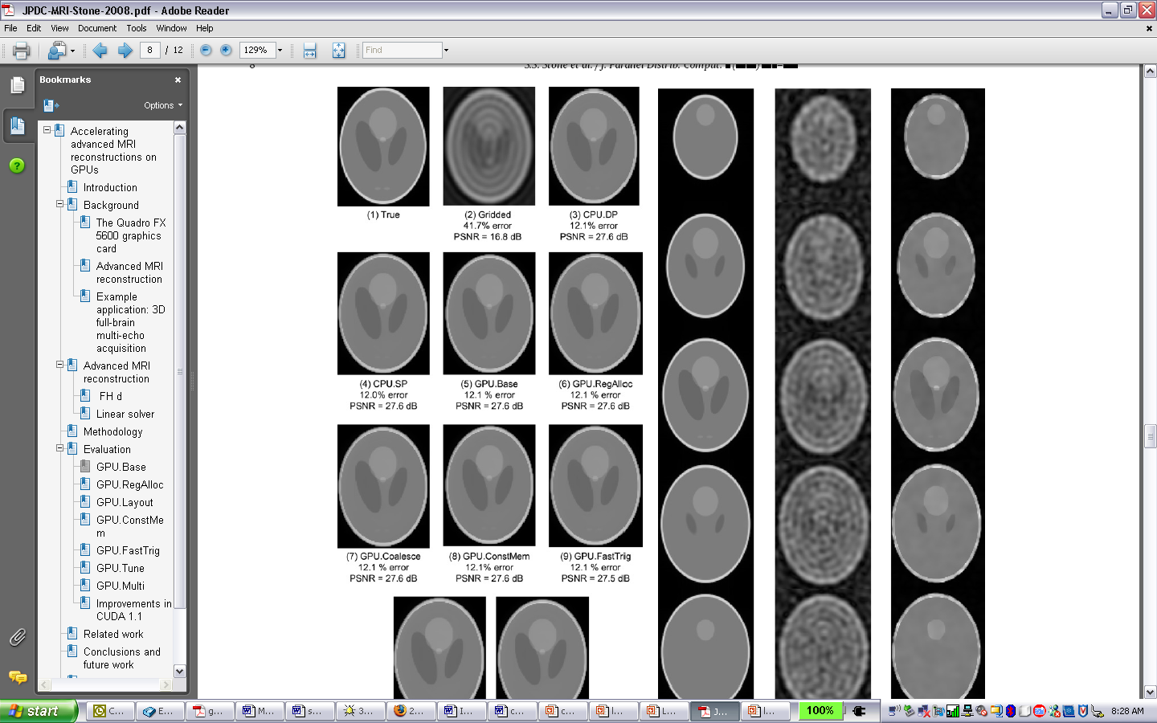
Validation of floating-point accuracy of the different FHD implementations.
Is the known image answer
(sometimes called a phantom image)
Note that all GPU optimized versions have comparable PSNR as (3) the CPU double-precision version

Slide 14
Component and Whole-Application Speedup
 | Q |  | F^{H}D |  | Total
Reconstruction | Run Time (m) | GFLOP | Run Time (m) | GFLOP | Linear Solver (m) | Recon. Time (m)
Gridding + FFT (CPU, DP) | N/A | N/A | N/A | N/A | N/A | 0.39
LS (CPU, DP) | 4009.0 | 0.3 | 518.0 | 0.4 | 1.59 | 519.59
LS (CPU, SP) | 2678.7 | 0.5 | 342.3 | 0.7 | 1.61 | 343.91
LS (GPU, Naïve) | 260.2 | 5.1 | 41.0 | 5.4 | 1.65 | 42.65
LS (GPU, CMem) | 72.0 | 18.6 | 9.8 | 22.8 | 1.57 | 11.37
LS (GPU, CMem, SFU, Exp) | 7.5 | 178.9 | 1.5 | 144.5 | 1.69 | 3.19
357X
228X
108X
30
Notes:
Also, relative to the CPU, the GPU achieves speedup of 357X for Q, 228X for FHd, and 108X for the reconstruction.
The acceleration for FHd is lower than the acceleration for Q most likely because FHd has two sines and two cosines in each inner loop, which may oversubscribe the SFUs.
The acceleration for the total reconstruction is only 108X because the linear solver, which initially accounted for less than 0.5% of the reconstruction, now accounts for roughly 50%. We expect that the running the solver on the G80 will cut the total reconstruction time to about 100 seconds.

Slide 15
The GPU Teaching Kit is licensed by NVIDIA and the University of Illinois under the Creative Commons Attribution-NonCommercial 4.0 International License.

